Slide 1

Recommender
Systems:
An Introduction

Slide 2






COMPANIES USING RECOMMENDOR SYSTEMS

Slide 3

PANDORA MUSIC RECOMMENDATION
How It Works:
Base its recommendation on data from Music Genome Project
Assigns 400 attributes for each song, done by musicians, takes half an hour per song
Use this method to find songs which is similar to user’s favorite songs
Benefits:
Accurate method, don’t need lots of users information, needs little to get started
Drawback:
Doesn't scale very well and often feels that Pandora's library is somewhat limited

Slide 4
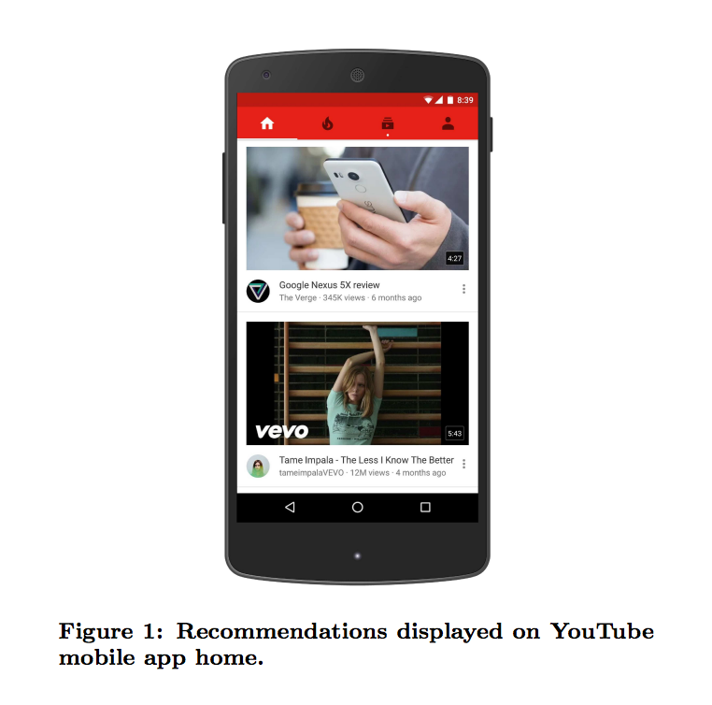
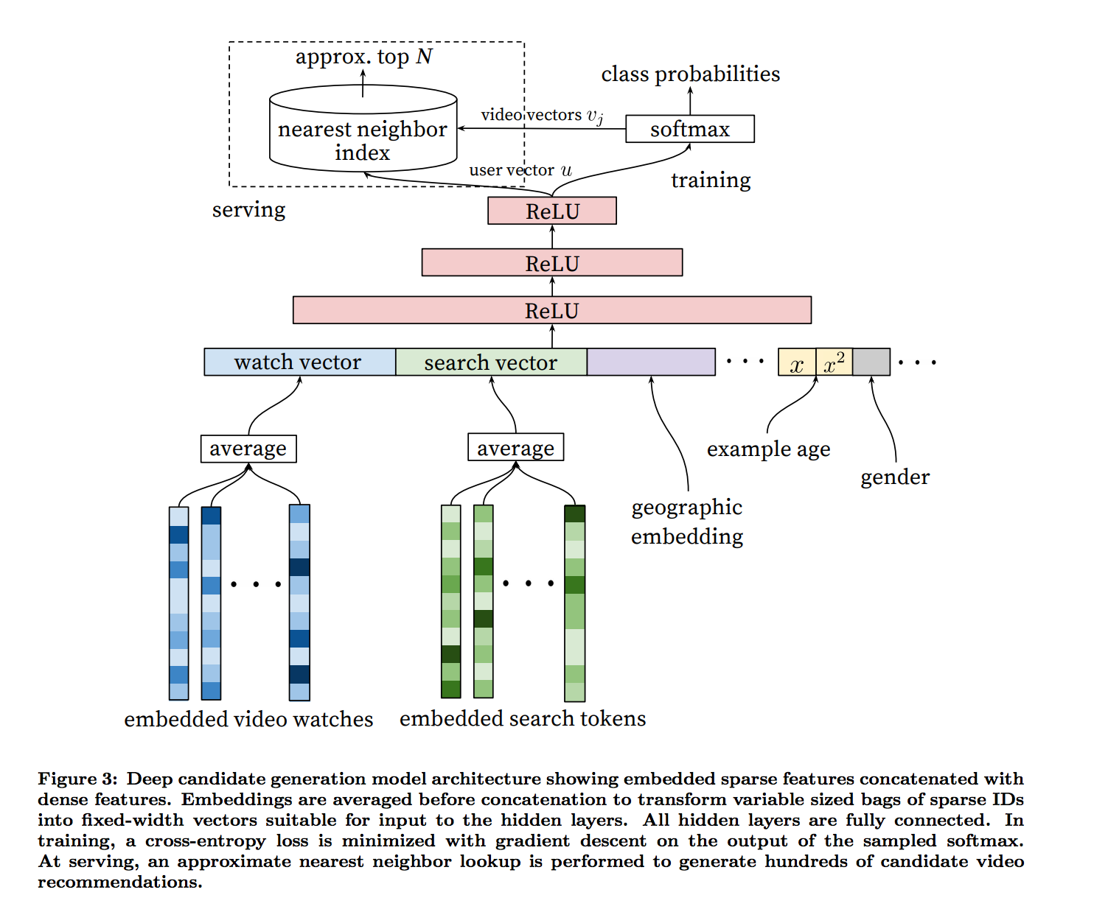
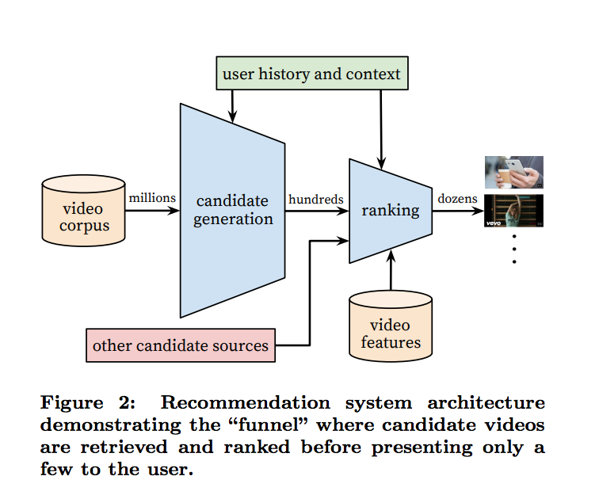
YOUTUBE VIDEO RECOMMENDATION

Slide 5
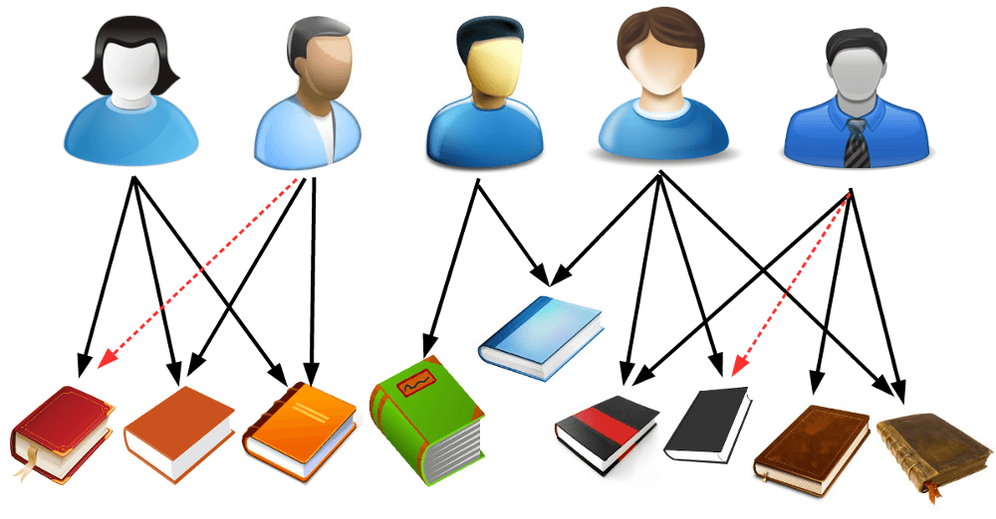
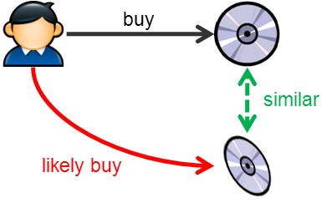
TYPE OF RECOMMENDER SYSTEM
Collaborative Recommender System
Content based Recommender System
Hybrid Recommender System

Slide 6
Techniques: Data Acquisition
1. Explicit Data
- Customer Ratings
- Feedback/Reviews
- Demographics
- Ephemeral Needs
2. Implicit Data
- Purchase History
- Click or Browse History
3. Product Information
- Product Taxonomy
- Product Attributes
- Product Descriptions

Slide 7
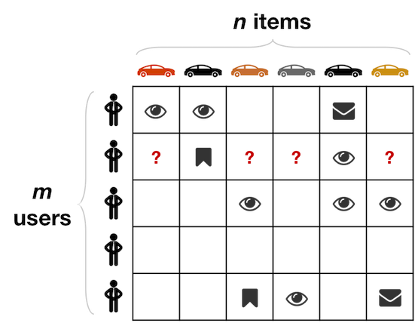
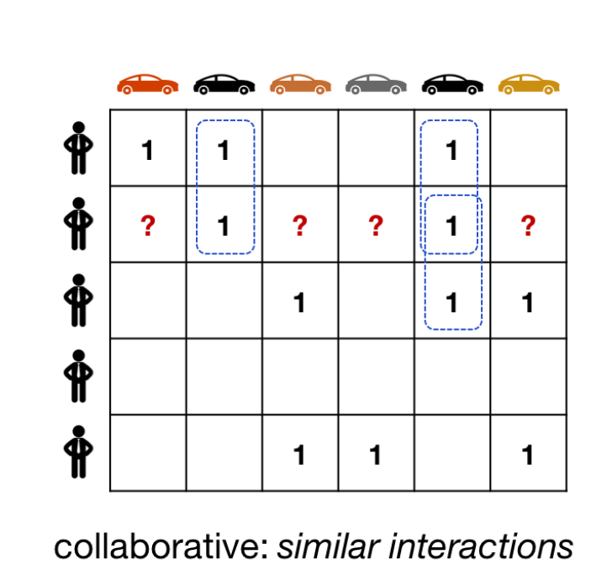
Collaborative Recommender System
Match people with similar interests as a basis for recommendation
Many people must participate to make it likely that a person with similar interests will be found
There must be a simple way for people to express their interests
There must be an efficient algorithm to match people with similar interests.

Slide 8
Feedback/Interest variable calculation
Implicit Feedback:
Time spent viewing the product
Number of times the product is viewed
Products in wish-list
Products brought
Explicit Feedback:
Rating given to a product
Comments left for a product
Which is better ?

Slide 9

Techniques in Use: Similarity Index
Approach
Represents a customer as an N-dimensional vector of items
Vector is positive for purchased or positively rated items and negative for negatively rated items
Based on cosine similarity: finds similar customers/users
Generates recommendations based on a few customers who are most similar to the user
Rank each item according to how many similar customers purchased it
Problems
computationally expensive, O(MN) in the worst case, where
M is the number of customers and
N is the number of items
dimensionality reduction can increase the performance, BUT, also reduce the quality of the recommendation
For very large data sets, such as 10 million customers and 1 million items, the algorithm encounters severe performance and scaling issues

Slide 10
Techniques in Use: Cluster Models
Approach
Divide the customer base into many segments and treat the task as a classification problem
Assign the user to the segment containing the most similar customers
Uses the purchases and ratings of the customers in the segment to generate recommendations
Cluster models have better online scalability and performance than collaborative filtering because they compare the user to a controlled number of segments rather than the entire customer base.
Problems
Quality of the recommendation is low
The recommendations are less relevant because the similar customers that the cluster models find are not the most similar customers
To improve quality, it needs online segmentation, which is almost as expensive as finding similar customers using collaborative filtering

Slide 11
Techniques in Use: Matrix Factorization
Matrix factorization assumes that:
Each user can be described by k attributes or features. For example, feature 1 might be a number that says how much each user likes sci-fi movies.
Each item (movie) can be described by an analagous set of k attributes or features. To correspond to the above example, feature 1 for the movie might be a number that says how close the movie is to pure sci-fi.
If we multiply each feature of the user by the corresponding feature of the movie and add everything together, this will be a good approximation for the rating the user would give that movie.

Slide 12


Techniques in Use: Matrix Factorization
That’s it. The beauty is that we do not know what these features are. Nor do we know how many (k) features are relevant. We simply pick a number for k and learn the relevant values for all the features for all the users and items. How do we learn? By minimizing a loss function, of course!
We can turn our matrix factorization approximation of a k-attribute user into math by letting a user u take the form of a k-dimensional vector x_u. Similarly, an item i can be k-dimensional vector y_i. User u’s predicted rating for item i is just the dot product of their two vectors.
where r_ui hat represents our prediction for the true rating r_ui, and y_i(x⊺_u) is assumed to be a column (row) vector. These user and item vectors are often called latent vectors or low-dimensional embeddings in the literature. The k attributes are often called the latent factors. We will choose to minimize the square of the difference between all ratings in our dataset (S) and our predictions. This produces a loss function of the form

Slide 13
Content based Recommender System
In content based recommender systems, keywords or properties of the items are taken into consideration while recommending an item to an user. So, in a nutshell it is like recommending similar items. Imagine you are reading a book on data visualization and want to look for other books on the same topic. In this scenario, content based recommender system would be apt.
We will look at three important concepts here which go into building this content based recommender system.
Vectors
TF-IDF
Cosine Similarity

Slide 14
TF — IDF
TF- IDF stands for Term Frequency and Inverse Document Frequency .TF-IDF helps in evaluating importance of a word in a document.
TF — Term Frequency
Step 1: Create a dictionary of words (also known as bag of words) present in the whole document space. We ignore some common words also called as stop words e.g. the, of, a, an, is etc, since these words are pretty common and it will not help us in our goal of choosing important words
B1 — Recommender Systems
B2 — The Elements of Statistical Learning
B3 — Recommender Systems — Advanced
Now creating an index of these words (stop words ignored)
1. Recommender 2. Systems 3 Elements 4. Statistical 5.Learning 6. Advanced

Slide 15
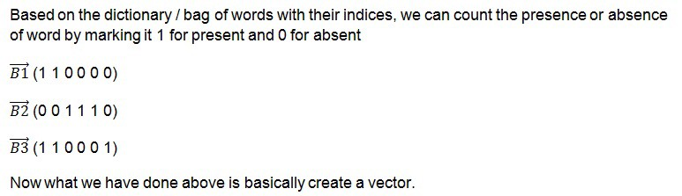
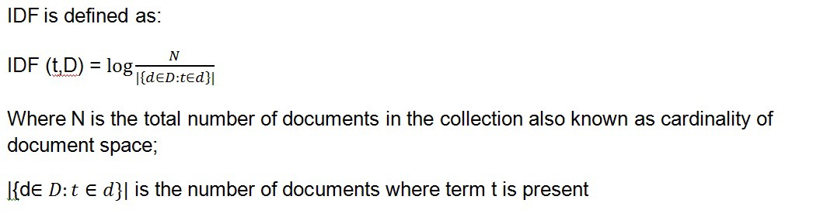
TF — IDF
IDF (Inverse Document Frequency):
In some variation of the IDF definition, 1 is added to the denominator so as to avoid a case of division by zero in the case of no terms being present in the document.
Basically a simple definition would be:
IDF = ln (Total number of documents / Number of documents with term t in it)

Slide 16
TF — IDF
TF-IDF Weight:
Now the final step would be to get the TF-IDF weight. The TF vector and IDF vector are converted into a matrix.
Then TF-IDF weight is represented as:
TF-IDF Weight = TF (t,d) * IDF(t,D)
Document 1
Term | Term Count
this | 1
is | 1
a | 2
sample | 1
Document 2
Term | Term Count
this | 1
is | 1
another | 2
example | 3
Find the tf-idf for “a”, “example” ?

Slide 17
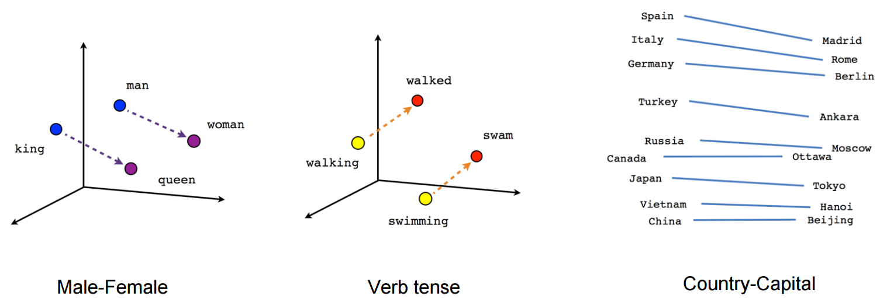
Vector- Prediction based Vector
How similar is pizza to pasta?
How related is pizza to Italy?
Representing words as vectors allows easy computation of similarity

Slide 18
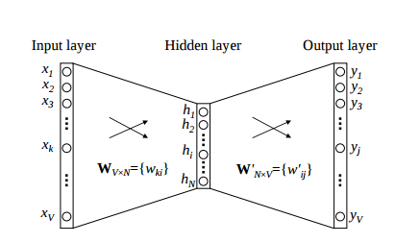
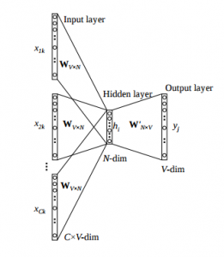
CBOW (Continuous Bag of words)
The way CBOW work is that it tends to predict the probability of a word given a context. A context may be a single word or a group of words
Example Input
Hey | this | is | sample | corpus | using | only | one | context | word
0 | 0 | 0 | 1 | 0 | 0 | 0 | 0 | 0 | 0

Slide 19
CBOW (Continuous Bag of words)
The flow is as follows:
The input layer and the target, both are one- hot encoded of size [1 X V]. Here V=10 in the above example.
There are two sets of weights. one is between the input and the hidden layer and second between hidden and output layer. Input-Hidden layer matrix size =[V X N] , hidden-Output layer matrix size =[N X V] : Where N is the number of dimensions we choose to represent our word in. It is arbitary and a hyper-parameter for a Neural Network. Also, N is the number of neurons in the hidden layer. Here, N=4.
There is a no activation function between any layers.( More specifically, I am referring to linear activation)
The input is multiplied by the input-hidden weights and called hidden activation. It is simply the corresponding row in the input-hidden matrix copied.
The hidden input gets multiplied by hidden- output weights and output is calculated.
Error between output and target is calculated and propagated back to re-adjust the weights.
The weight between the hidden layer and the output layer is taken as the word vector representation of the word.

Slide 20
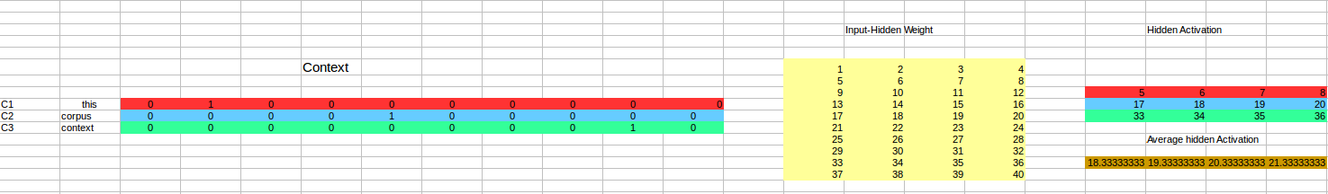
CBOW (Continuous Bag of words)
Advantages of CBOW:
Being probabilistic is nature, it is supposed to perform superior to deterministic methods(generally).
It is low on memory. It does not need to have huge RAM requirements like that of co-occurrence matrix where it needs to store three huge matrices.
Disadvantages of CBOW:
CBOW takes the average of the context of a word (as seen above in calculation of hidden activation). For example, Apple can be both a fruit and a company but CBOW takes an average of both the contexts and places it in between a cluster for fruits and companies.
Training a CBOW from scratch can take forever if not properly optimized.

Slide 21
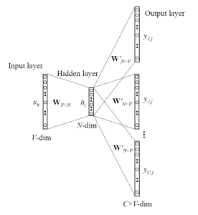
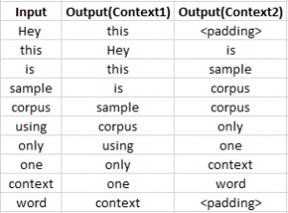
Skip-Gram Model
Skip – gram follows the same topology as of CBOW. It just flips CBOW’s architecture on its head. The aim of skip-gram is to predict the context given a word

Slide 22
Skip-Gram Model
Skip – gram follows the same topology as of CBOW. It just flips CBOW’s architecture on its head. The aim of skip-gram is to predict the context given a word
Advantages of Skip-Gram Model
Better for a smaller corpus
Skip-gram with negative sub-sampling outperforms every other method generally.

Slide 23
PRE-TRAINED EMBEDDINGS

Slide 24
Questions?

